Slide 1

The GOAT Transportation Portal Mobile APP
Software Project Management Project
Sarper Sarp – Doğa Yıldız – Aslıhan Gök
Doruk Üngör – Ediz Özdil – Çağatay Tuğcu Mehmed Arslan Aras – Güngör Parlak

Slide 2
Transportation Portal Mobile Application mainly focused on that enables city residents and guests to learn more about a city’s transportation-related features. Aspects include details about available public transportation, schedules, costs, money-handling procedures, and other things (tutorial). The application may also offer current bus and other public transportation locations in real-time
Transportation can always be complicated. This is exactly when you need a companion app at your fingertips. Who doesn't want a helper who can measure roads, timetables, and distances that can help everywhere in or out of the country, in or out of the city? Simply put, we've all wondered how much a taxi will cost for the distance we're going. This app will calculate and present you with how much to drive for an all-inclusive location. It will offer short or long options and will tell you to the minute. This project will be the kind of application that every person will need many times in their life.

Slide 3
This application is a popular application among people who use public transport daily.
This application contains an average of 3 alternative routes per each result achieved.
This application is a public transit application that is the most preferred and contains the most data.
Thanks to this application, 90% of users can easily find the route they are looking for.
This application includes alternative transportation routes for people to arrive as soon as possible.

Slide 4
Our application in our project can be easily used by all age groups. It will enable people to save time as an example that will help their daily lives in many areas. The project we are aiming for has a specific interface within measurable limits. The project is in specific, measurable, achievable, relevant and time bound for us.
In the application, the cost of each transportation vehicle, how long it will reach, and the frequency of the trip will be available. In addition, it will offer many options for different transportation routes, and map extensions for all transportation routes will be included in our application. We will also announce new flights from within the application. You will be able to star your favorite places from the app. You will be able to examine all vehicle options one by one.

Slide 5
The application should be accessible to users at all hours of the day.
The application should record any interaction between the user and the system.
1
2
3
4
5
The application will get updates frequently.
The application should protect users account information via related device.
The application's interface should be simple and understandable.

Slide 6
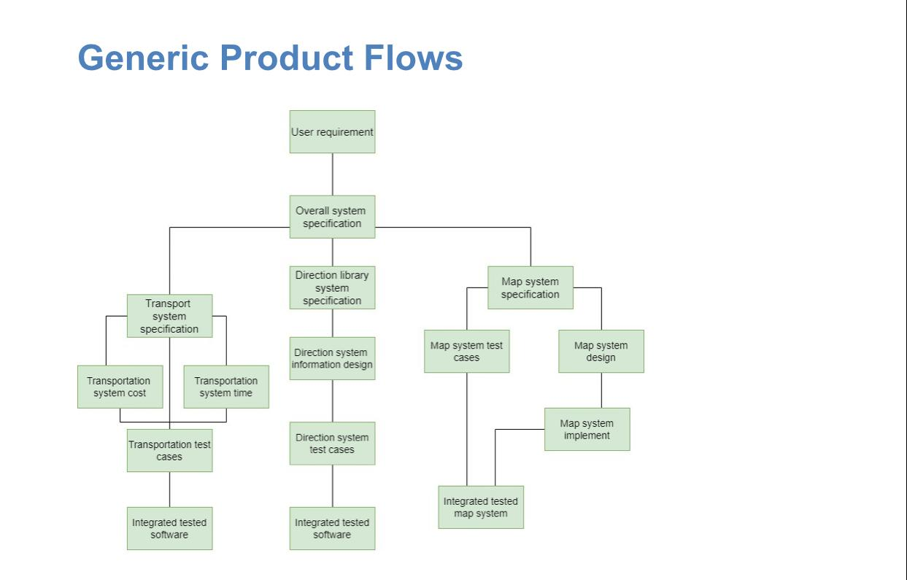

Slide 7
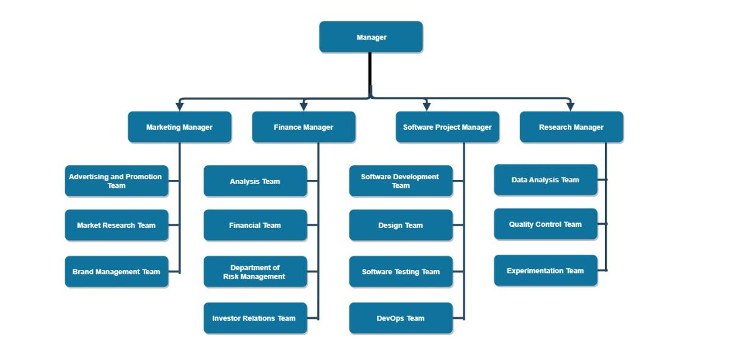
A
B
C
D

Slide 8
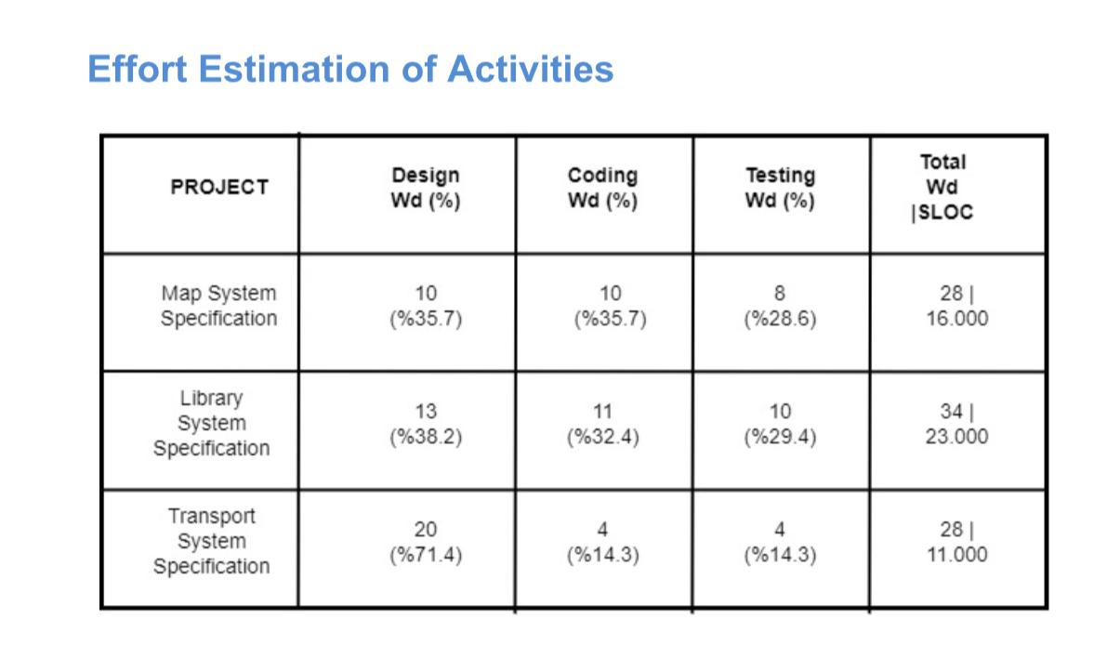

Slide 9
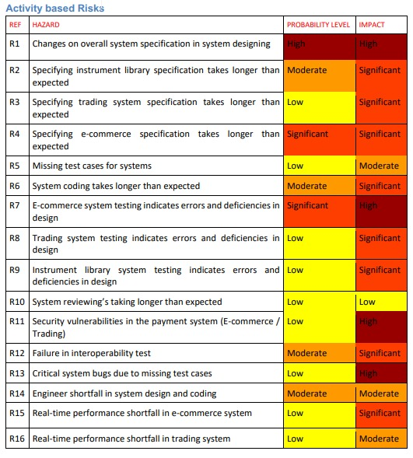

Slide 10
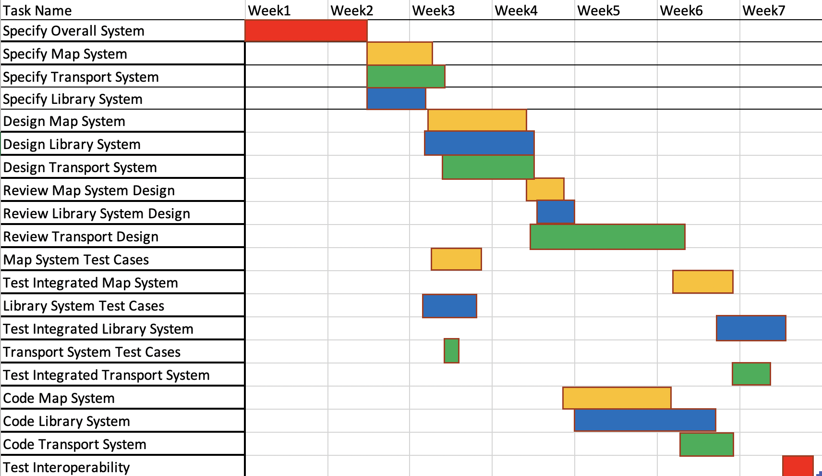
All
Sarper & Çağatay & Güngör
Aslıhan & Doğa & Ediz
Mehmed & Doruk

